Slide 1
Probability distributions

Slide 2
Probability distribution
It provides possible outcome of a variable with their probabilities.

Slide 3
Random variable
Random due to chance is relevant.
Two types:-
Discrete
Continuous

Slide 4
Discrete variable
Countable number of distinct values. Eg: 0,1,2,3
If a random number can take finite number of values, then it must be discrete.
Examples:- No of children in a family.

Slide 5
Continuous variable
Infinite no of possible values.
Eg height, age, temperature or time.

Slide 6
Probability mass function
Probability distribution of a discrete random variable

Slide 7
Probability density function
Probability distribution of a continuous variable.

Slide 8
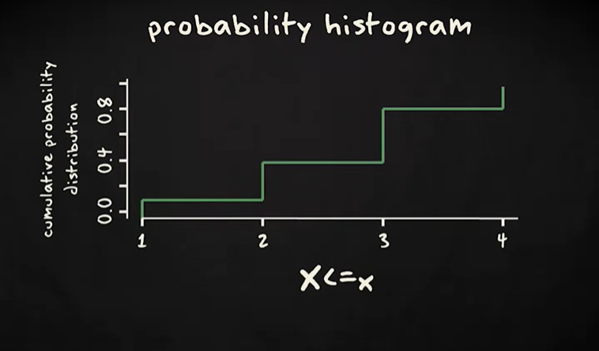
Cumulative probability distribution

Slide 9
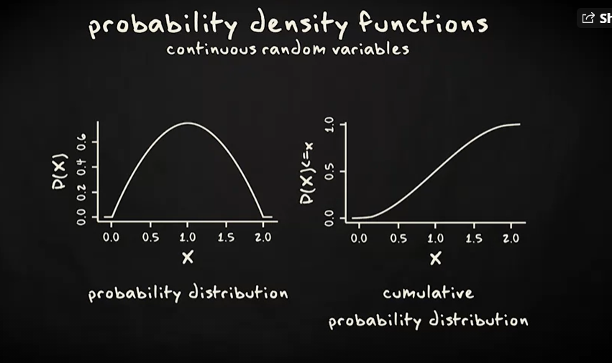
Cumulative distribution function

Slide 10
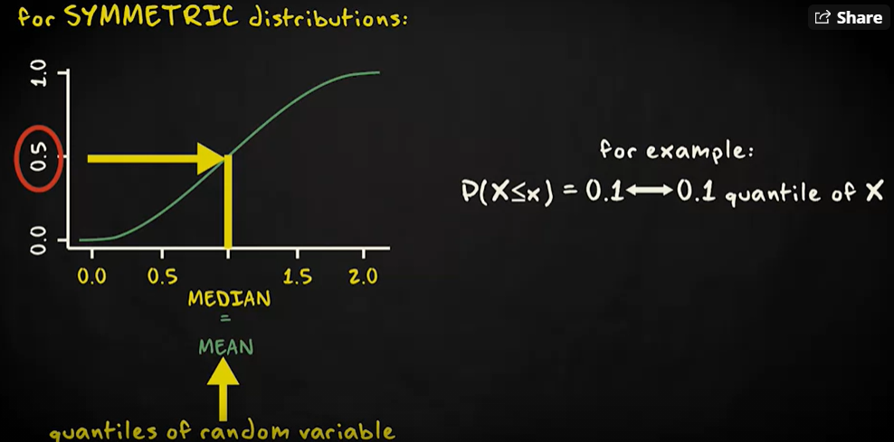
Cumulative distribution function

Slide 11
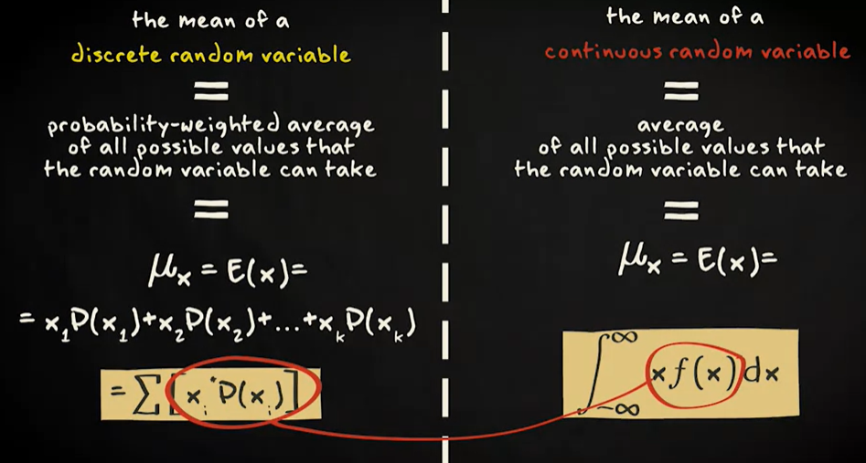
Mean of a probability function
Expected outcome of an observation.

Slide 12
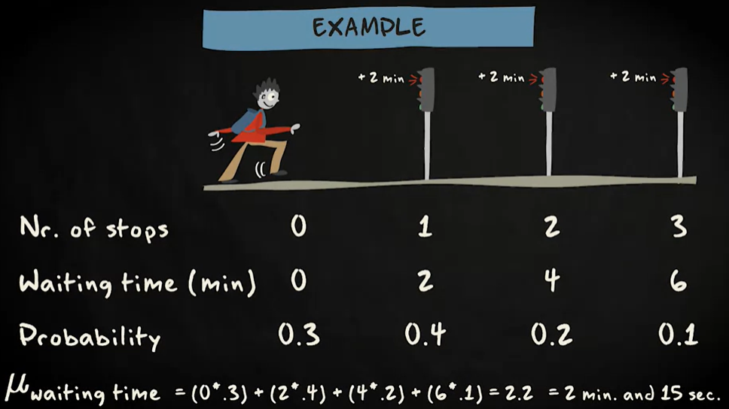

Slide 13
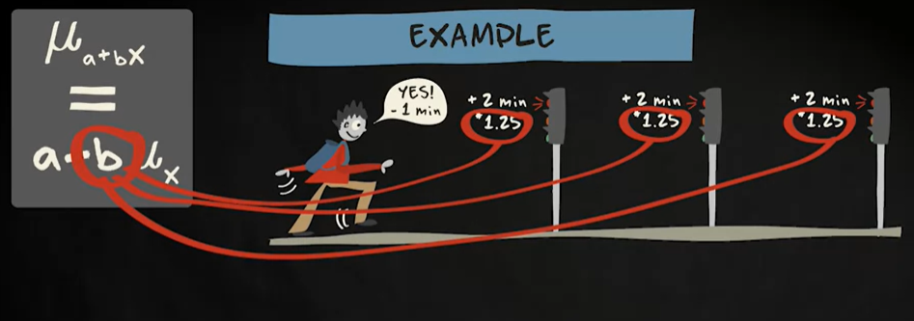


Slide 14
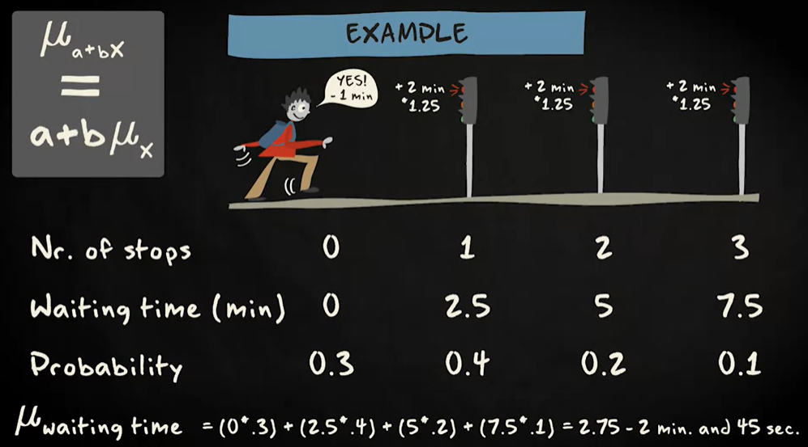

Slide 15
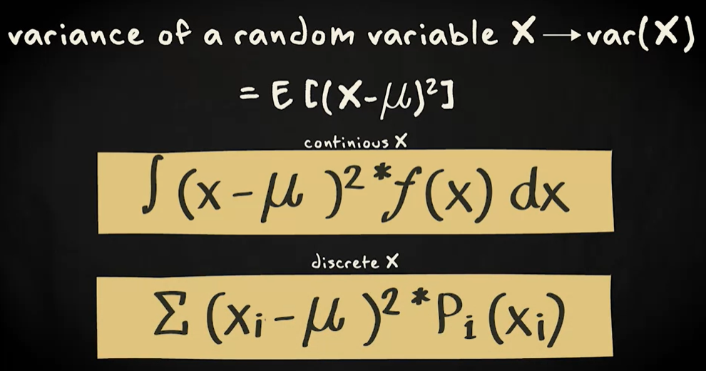
Variance of a random variable
It is a measure of spread.

Slide 16
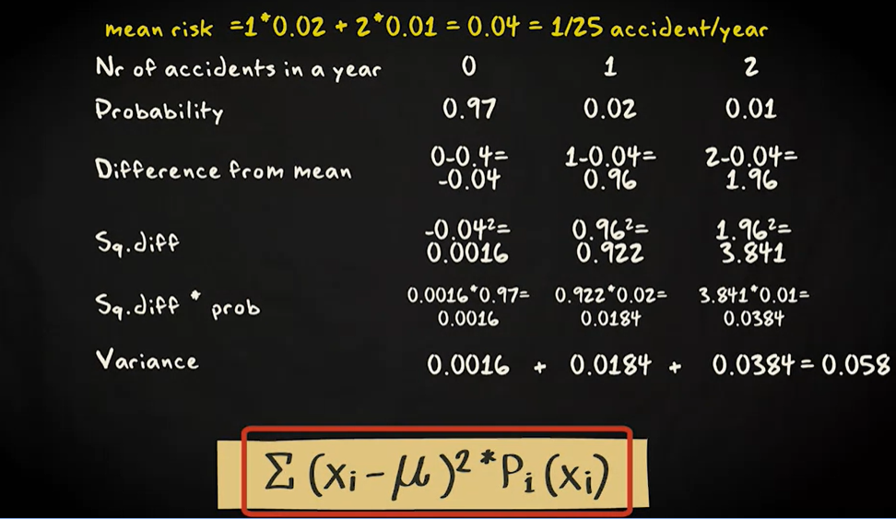

Slide 17
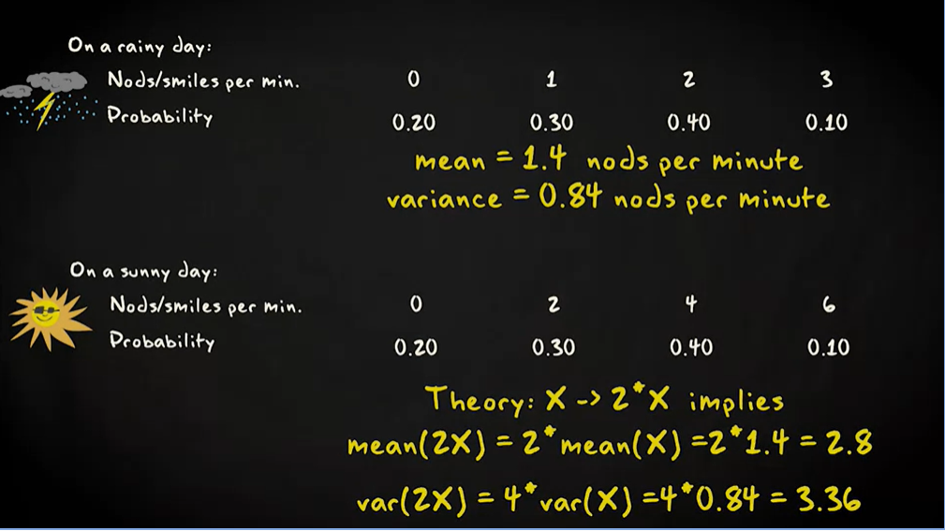

Slide 18
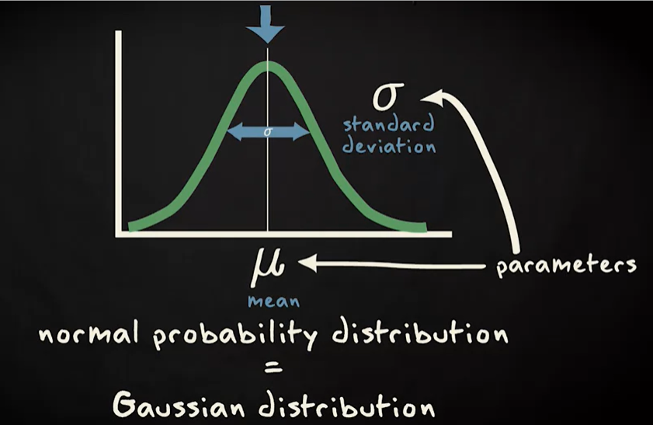
Normal distribution
It is also called Gaussian distribution.
It is symmetric, bell shaped and characterized by mean and vaiance.

Slide 19
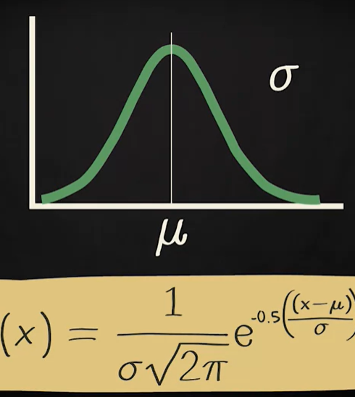
Equation of a Normal distribution

Slide 20
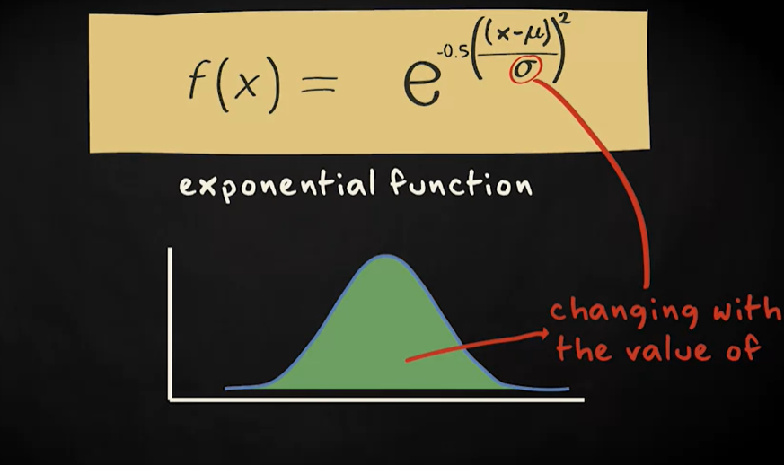

Slide 21
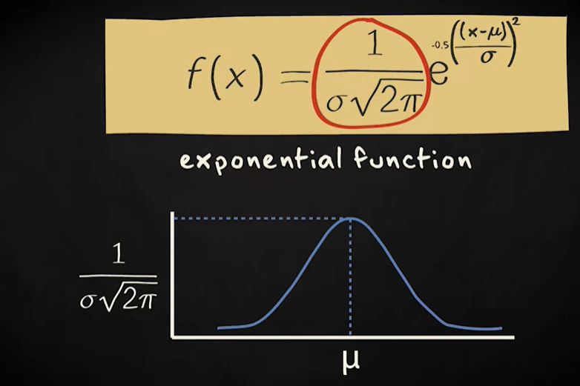

Slide 22
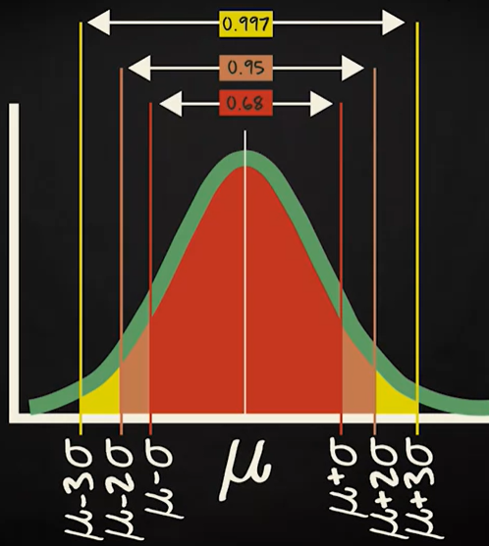
Normal distribution

Slide 23
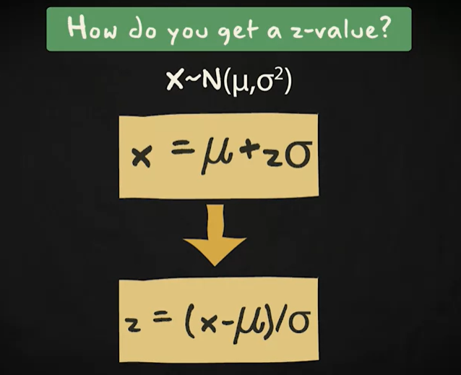
Standard Normal distribution

Slide 24
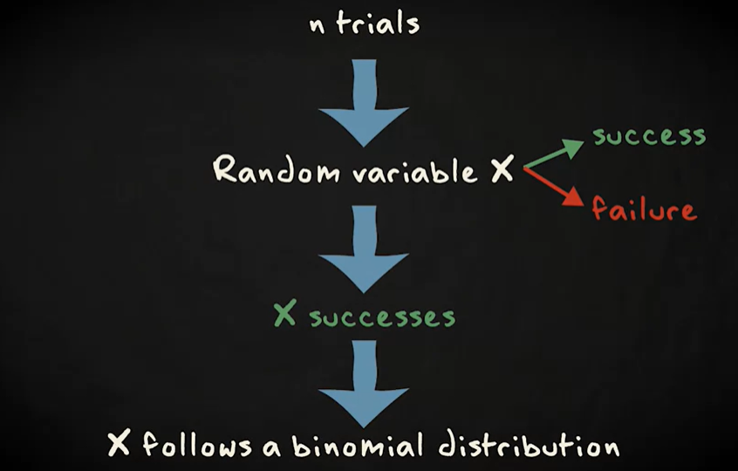
Binomial distribution It is a discrete probability distribution with two outcomes success or failure

Slide 25
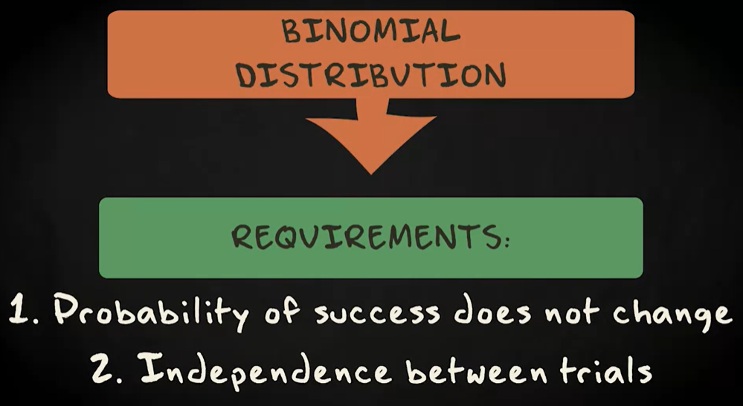

Slide 26
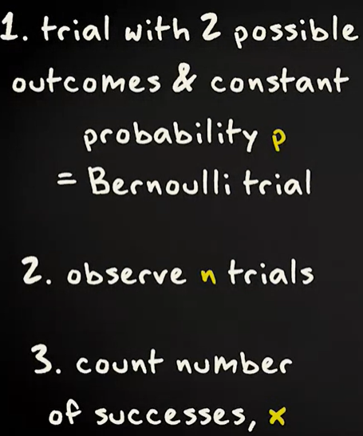
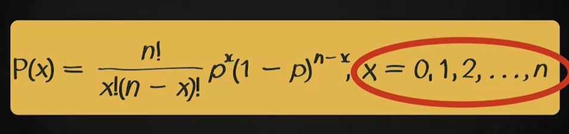
Formula for Binomial distribution

Slide 27
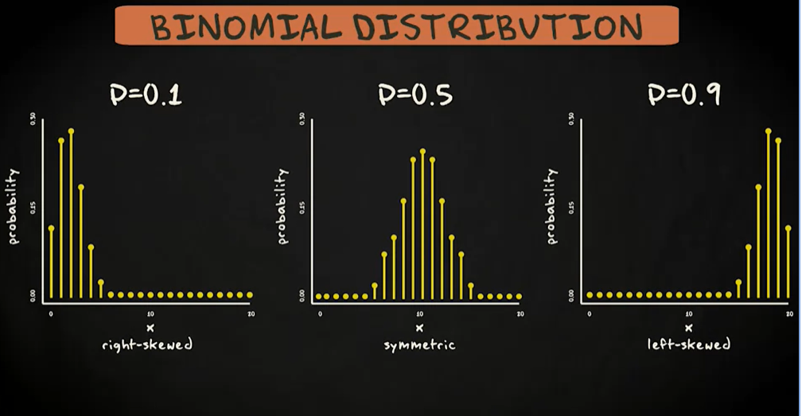

Slide 28
